Slide 1
PJ Our Way Games Together TRIVIA!

Slide 2
Here’s how to play!
Got your paper and pen ready?
You’ll have 2 minutes for each question
Don’t know an answer? No prob! Take a wild guess!
Facilitator, for each slide, click on the timer to activate it. It will slowly fill up and will say “end” after 2 minutes (Or use your own timer.)
Share answers at the end of the game
Have FUN!

Slide 3
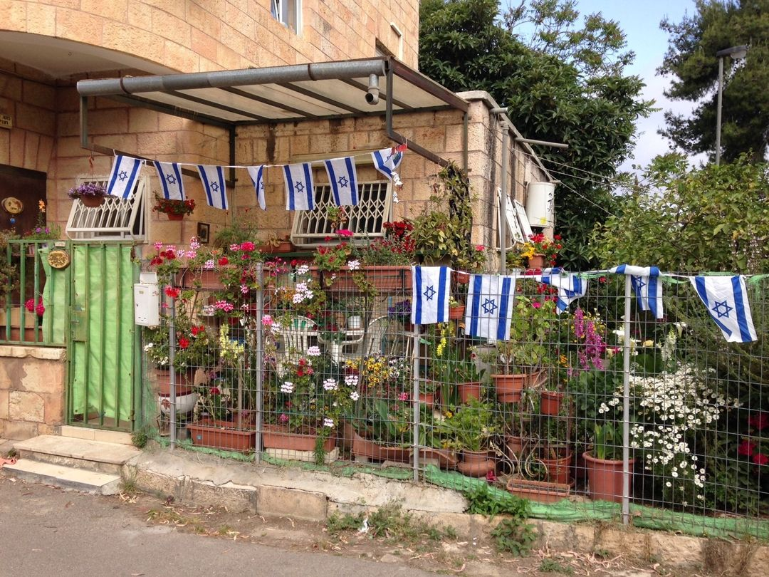
1. Name one country that Israel touches.
2 minutes
End

Slide 4
2. Which Jewish singer won a Nobel Prize?
2 minutes
End

Slide 5
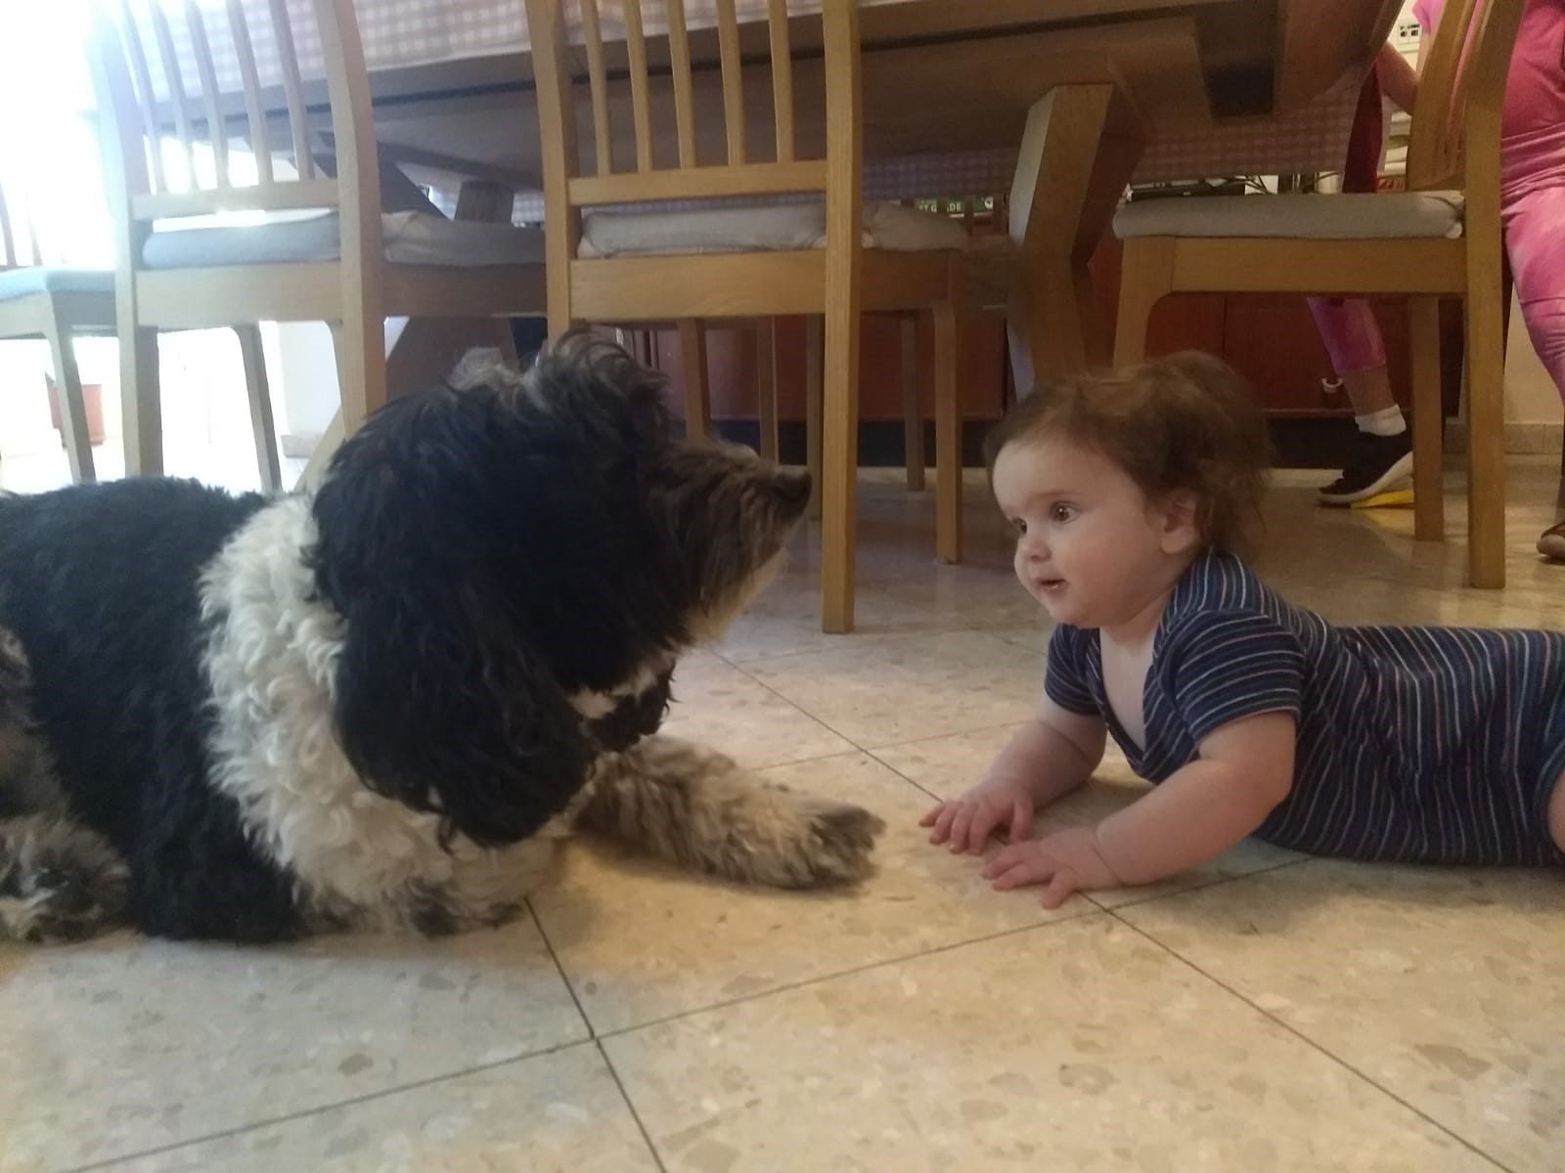
3. Name two languages that they speak in Israel.
2 minutes
End

Slide 6
4. What title goes with this PJ Our Way book?
2 minutes
End

Slide 7
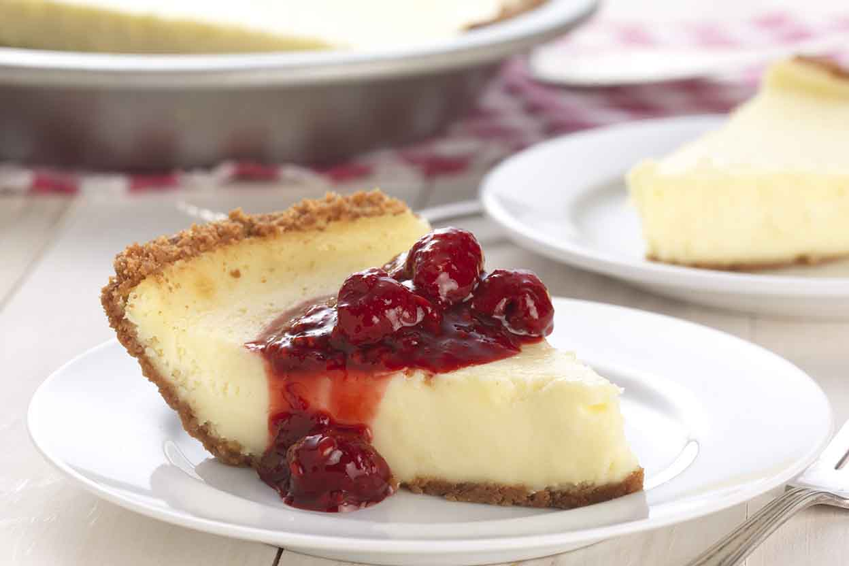
5. Which Jewish holiday do we eat cheesecake?
2 minutes
End

Slide 8
6. Bonus! Write down as many PJ Our Way books as you can in 2 minutes!
(1 point for every book you name!)
2 minutes
End

Slide 9
How did you do?
Name one country that Israel touches. Answer: Egypt, Jordan, Syria, Lebanon
Which Jewish singer won a Nobel Prize? Answer: Bob Dylan
Name two languages they speak in Israel Answer: Hebrew, Arabic are official. Russian, English, and lot of other languages are also spoken, see: https://en.wikipedia.org/wiki/Languages_of_Israel
Which PJ Our Way book is this? Answer: How to Survive Middle School
On which holiday do we eat cheesecake? Answer: Shavuot!

