Slide 1
All Around the Year
With The PJ Library
Second in a Series of Monthly Webinars
Tuesday, October 12, 2010
Offered by Hebrew College
Vivian Newman, Instructor
We recommend using the telephone for audio.
Select ‘Use Telephone’ under the Audio settings.
Dial the number shown in the audio tab.
Enter Access Code when asked.
Enter Audio PIN.

Slide 2
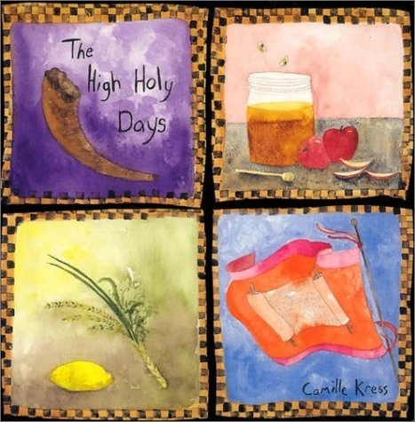
All AROUND THE Year with the PJ Library-
Webinar 2

Slide 3
Hebrew College Course Information
Course Participants attend 5 of the 8 monthly webinars
Webinars are held the second Tuesday of every month
Course participants will have have access to:
-supplemental course readings
- videos of programs in action
- guidance and feedback,
as they create their own
beyond-the- book program

Slide 4
To register for the course
Contact Rachel Raz
by Tuesday,
October 19, 2010
rraz@hebrewcollege.edu 617-559-8629

Slide 5
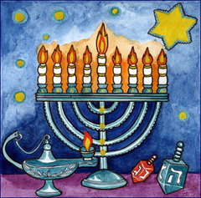
The How's, What's, and Why's of Hanukkah Programming
Hanukkah: December 1-9, 2010

Slide 6


Goals of Holiday –Based Programs:
  To create excitement for the upcoming holiday
  To enhance a family’s understanding of the history,
rituals, and customs associated with the holiday
  To provide families with concrete take- home tools for enriching the home celebration .
  To inform families of holiday celebrations occurring within the community

Slide 7
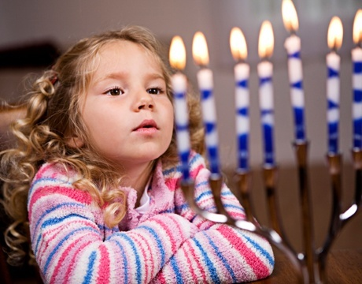
Goals of Hanukkah Programs
To provide families with numerous opportunities to explore the ritual objects/ symbols of Hanukkah
To increase a family’s Hanukkah vocabulary and to enrich their understanding of the holiday
For families to share ideas with one another on meaningful ways to celebrate Hanukkah
For families to have fun

Slide 8
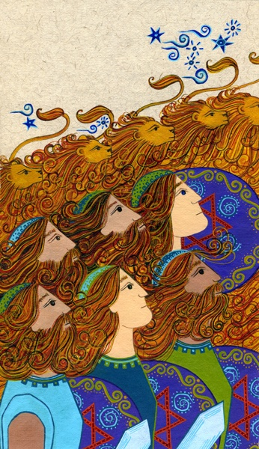
Text Study: What is Hanukkah?
    From the Apocrypha: 1 Maccabees 1:41-51
    Moreover king Antiochus wrote to his whole kingdom, that all should be one people. ,And every one should leave his laws: so all the heathen agreed according to the commandment of the king. Yea, many also of the Israelites consented to his religion, and sacrificed unto idols, and profaned the Sabbath …And he[Antochus] commanded the holy place to be profaned, and the holy people of Israel and he commanded…that they should leave their children uncircumcised, and let their souls be defiled …that they should forget the law and should change all the justifications of G-d.

Slide 9
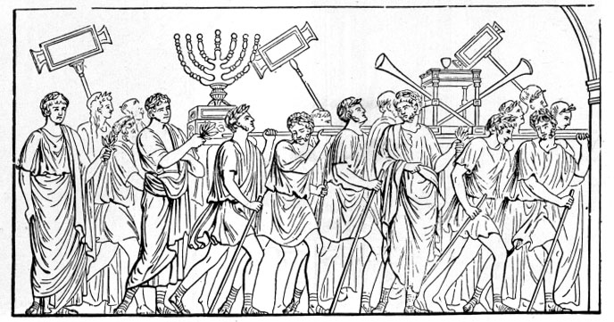
Hanukkah Sources Continued
From the Apocrypha: 2 Maccabees 10:1-9
Now Maccabeus and his company, the Lord guiding them, recovered the temple and the city..And having cleansed the temple they made another altar, and striking stones they took fire out of them, and offered a sacrifice after two years, and set forth incense, and lights, and showbread. When that was done, they fell flat down, and besought the Lord that they might come no more into such troubles…And they kept the eight days with gladness, as in the feast of Succot…They ordained that every year those days [beginning on the 25th of Kislev] should be kept of the whole nation of the Jews.

Slide 10
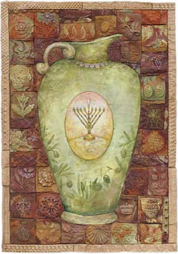
More Hanukkah Sources
  Babylonian Talmud, Shabbat 21b
    What is the reason for Chanukah? For our Rabbis taught: On the twenty-fifth day of Kislev the eight days of Chanukah begin… For when the Greeks entered the Temple, they defiled all the oils therein, and when the Hasmonean dynasty prevailed and defeated them, they made search and found only one cruse of oil which lay with the seal of the High Priest, but which contained sufficient [oil] for one day's lighting only; yet a miracle was wrought therein and they lit the lamp therewith for eight days. The following year these days were declared a Festival with the recitation of Hallel (hymns of praise) and thanksgiving."

Slide 11
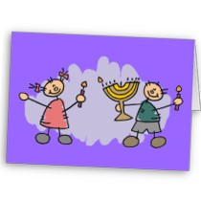
Some Themes of Hanukkah
Religious Freedom
Toleration and respect
for all religions
Awareness of the miracles-both large and small within one’s life
Optimism, hope
Courage and perseverance in the face of challenges
Centrality of the home/family in Jewish life

Slide 12
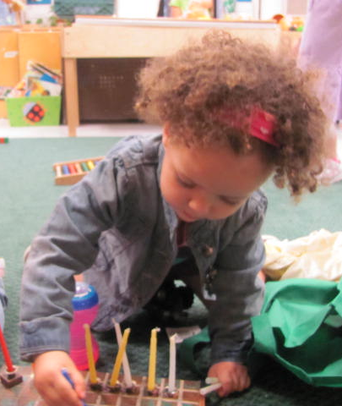
Methods for Conveying the Lessons/Themes of Hanukkah
Sharing of a PJ Library Book
Developmentally- Appropriate
Activities
Discussion, Communication
with children and parents
Informative, Concise Take Home Materials

Slide 13
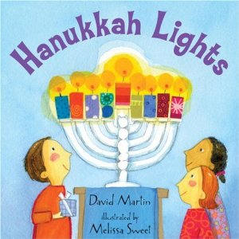
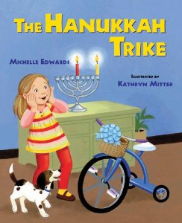
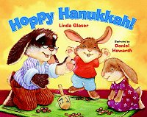
Titles of PJ Hanukkah Books for Children Ages 3 and Under:

Slide 14
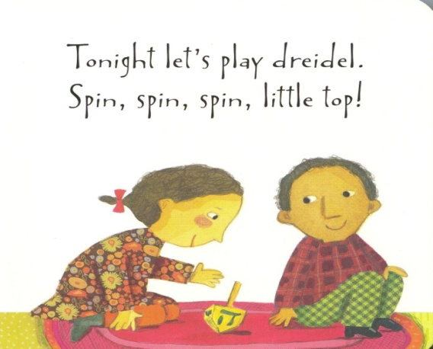
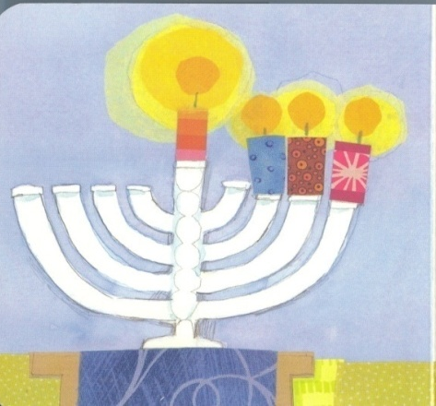
Why Hanukkah Lights?
Clear Pictures
Multi-Ethnic Families
Displays the joys of Hanukkah (singing and dancing with friends, reading with sister)
Illustrates how to light a menorah

Slide 15
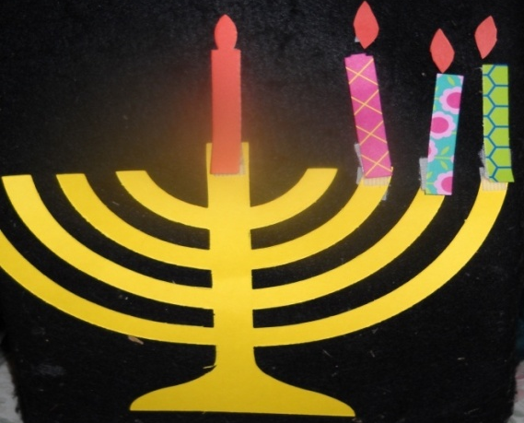
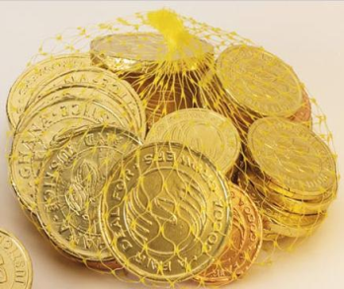
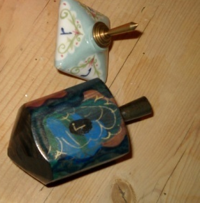
Hints for Sharing Hanukkah Lights
Enlarge pictures
Create a paper menorah similar
to the one displayed in the book.
Add a new candle to the paper
menorah each time a new candle
appears in the book’s illustrations.
Display matching 3-D objects
“Tonight let’s
play dreidel”
“Hanukkah gelt…shiny gold,
then yummy sweet”

Slide 16
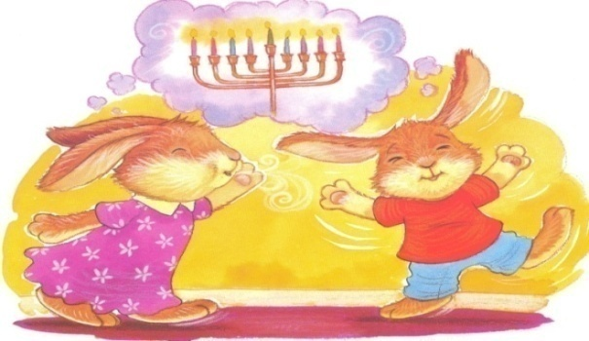
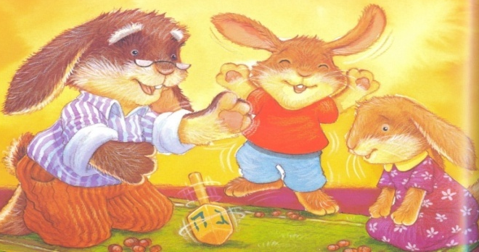
Why Hoppy Hanukkah?
Young children can identify with these active, loveable bunnies
Familiarizes children with the rituals and symbols of Hanukkah
Emphasizes that spending time with family is “the best” part of Hanukkah

Slide 17
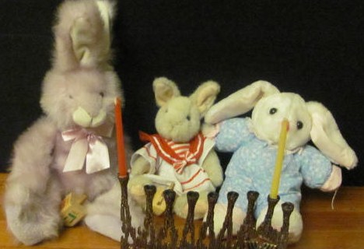
Hints for Sharing
Hoppy Hanukkah
Use bunny puppets and/or stuffed animals
Display realistic objects
Encourage children to imitate
the bunnies’ actions
After reading the story, ask children to describe their favorite part of Hanukkah.

Slide 18
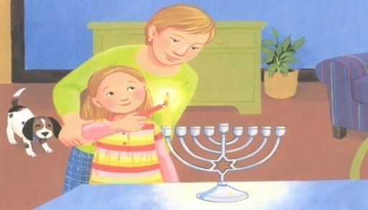
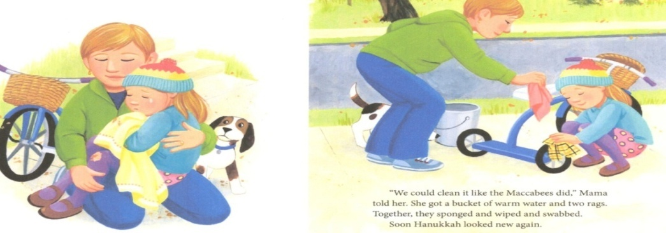
The Plot of The Hanukkah Trike
Story depicts what happens in Gabby Greenberg’s house on the first night of Hanukkah.
Gabby meets with frustration as she tries to ride her new “Hanukkah” trike.
Inspired by the Hanukkah story, Gabi cleans her fallen bike and triumphantly masters bike riding, proving that she is “brave like the Maccabees”.

Slide 19
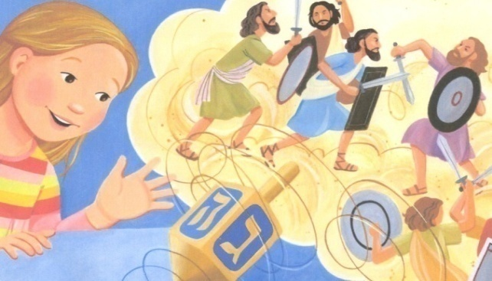
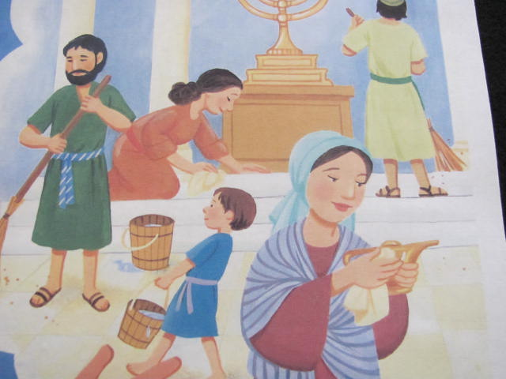
Why the Hanukkah Trike?
Young children can easily identify with Gabby.
Clearly depicts the rituals and
customs of Hanukkah
Contains a brief telling
of the Hanukkah story
Emphasizes the themes of
courage and perseverance and demonstrates how the story of Hanukkah can have relevance today.

Slide 20
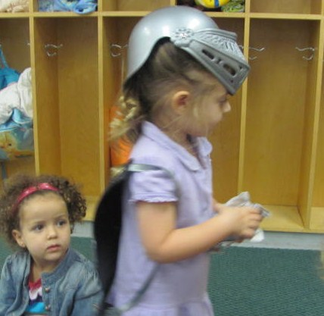
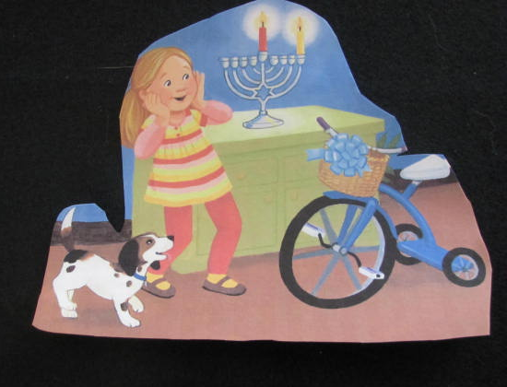
Tips for Sharing
The Hanukkah Trike
Use flannel board cut-outs (Be sure to define the term “trike”.)
Consider asking children to act out the story of Hanukkah.
Ask children to describe moments when they or someone they know needed to act bravely.

Slide 21
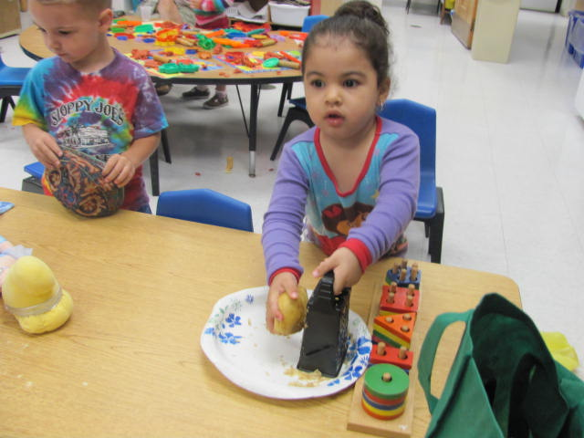
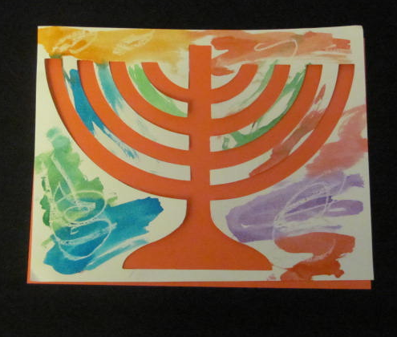
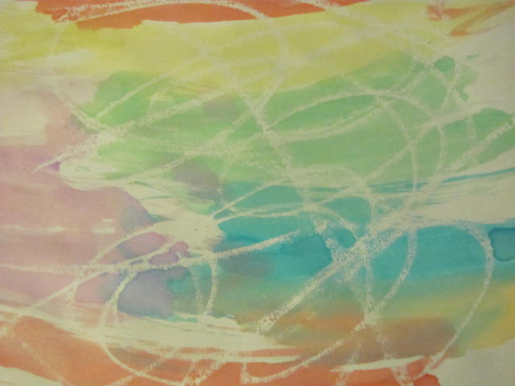
Characteristics of Developmentally Appropriate Activities
Open Ended
Involve the Use of the Senses
Simple, easily mastered
Interesting –encourage
prolonged exploration

Slide 22
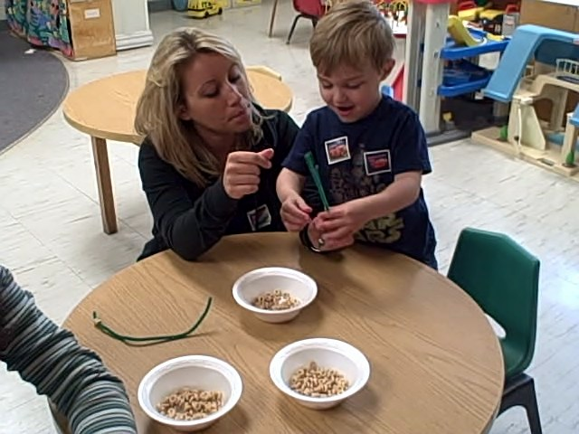
Guidelines for Setting up Activities
Minimize Waiting Time
Avoid Sharing of
Materials
Set up stations/ Have several
activities occurring
simultaneously
Maximize Parent- Child
Interaction

Slide 23
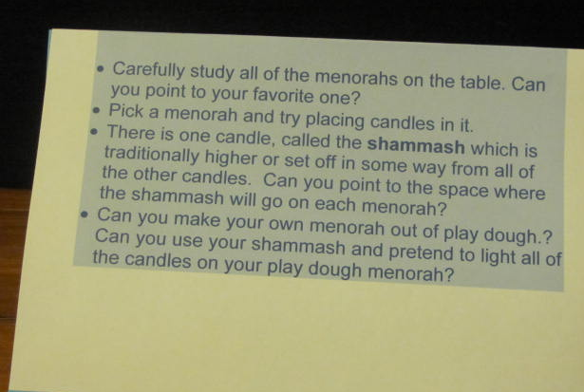
More Guidelines for Setting Up Activities
Keep instructions, simple,
clear, and educational
Plan for clean-up
Over-plan-
Plan for more
rather than less activities
There is one candle called the shammash which is higher or set off in some way from all of the other candles. Can you point to the space where the shammash will go on each menorah?

Slide 24
When to Hold Activities
As families arrive
As the book is being introduced
Can use a holiday bag to hold
ritual objects which will be displayed
After the book reading

Slide 25
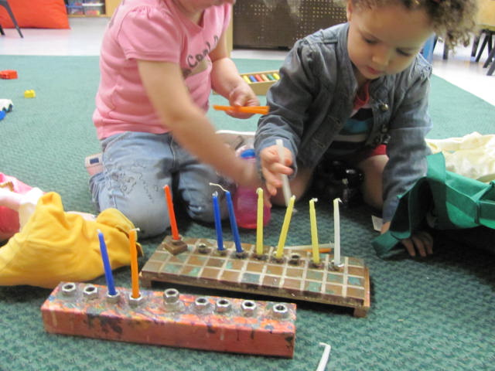
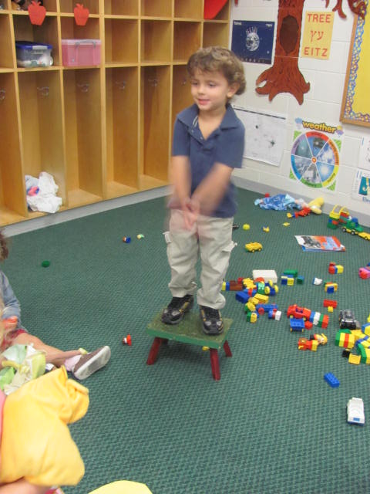
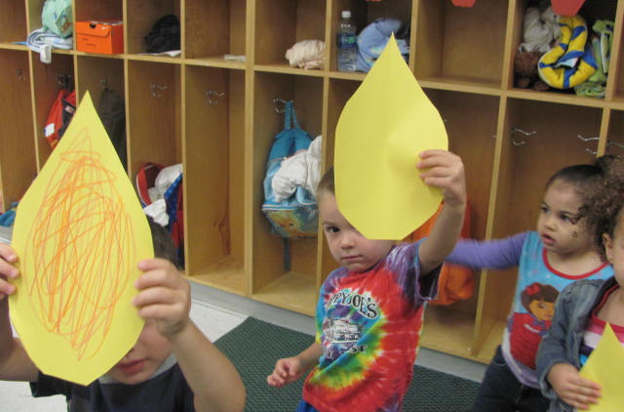
Menorah Activities
Placing candles in
menorahs
Candle Art
Human
Menorahs

Slide 26
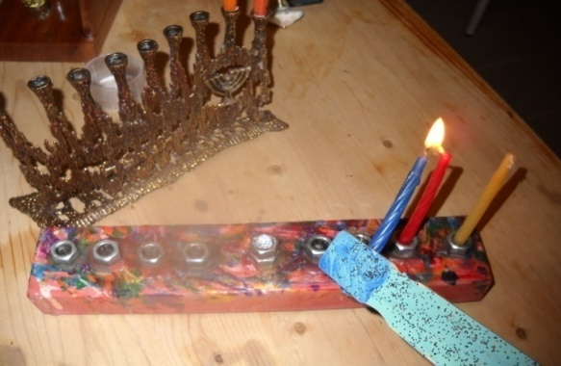
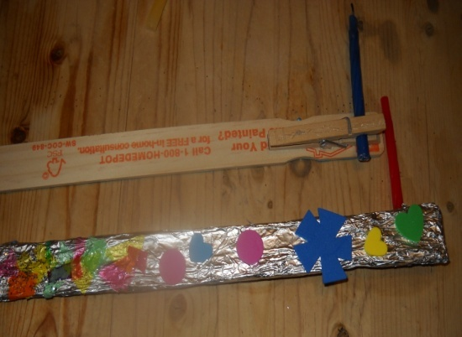
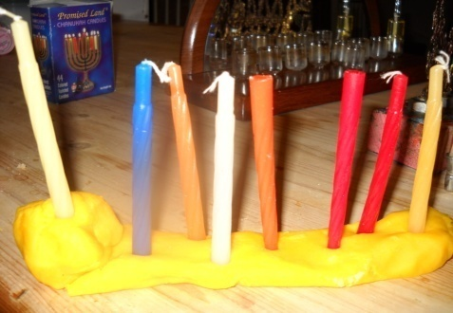
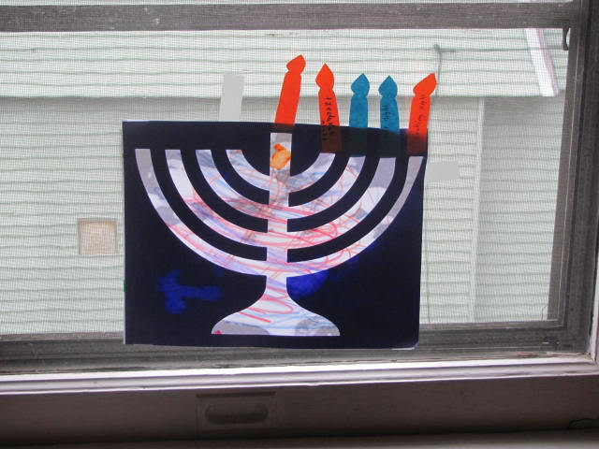
More Menorah Activities
Making Menorah Safety
Lighters
Lighting an oil menorah
Making play dough,
wooden, or
sculpy dough
menorahs
Oil Art

Slide 27
Menorah Teaching Points
Chanukiya is a Hebrew word for menorah
A Menorah is placed in a window so that all who pass by will see (This is known as the mitzvah of pirsum hanes ).
Shammash-a helper candle, is used to light all of the other candles
There is a custom to refrain from work as the candles burn.
We add one candle for each night of Hanukkah
We light the candles from left to right-from the newest candle to the oldest.

Slide 28
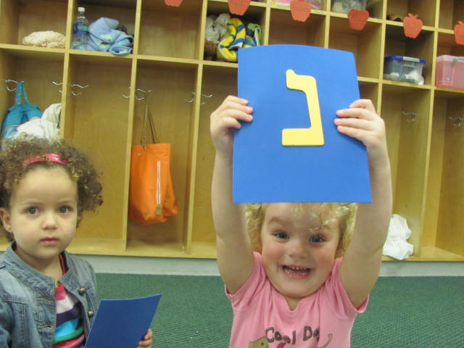
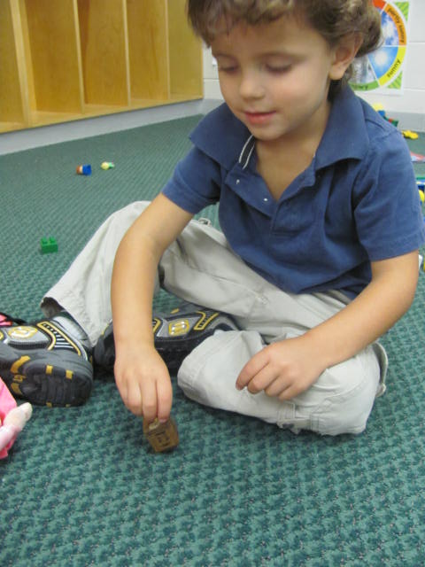
Dreidel Activities
Movement Games-Spin like a dreidel
Dreidel Letter Identification Game
Find the Hidden Dreidel (s)
Dreidel Contests
Paint with a dreidel

Slide 29
Dreidel Teaching Points
A dreidel is a toy which children all around the world play with on Hanukkah
There are Hebrew letters on the dreidel.
The Hebrew letters on the dreidel refer to the words Nes Gadol Haya Shum (A great miracle happened there.)
According to tradition, Jews played with dreidels in order to hide the fact that they were gathering and observing Jewish rituals in secret.

Slide 30
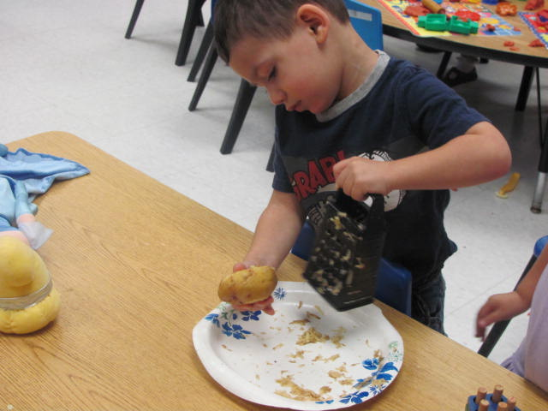
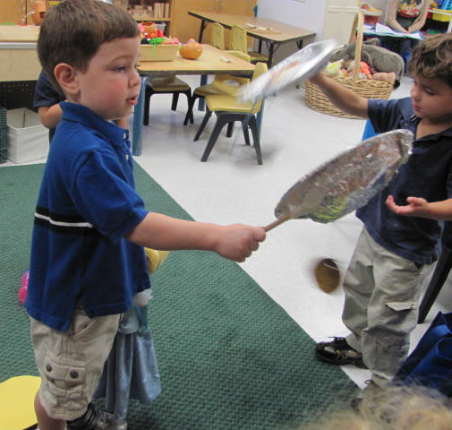
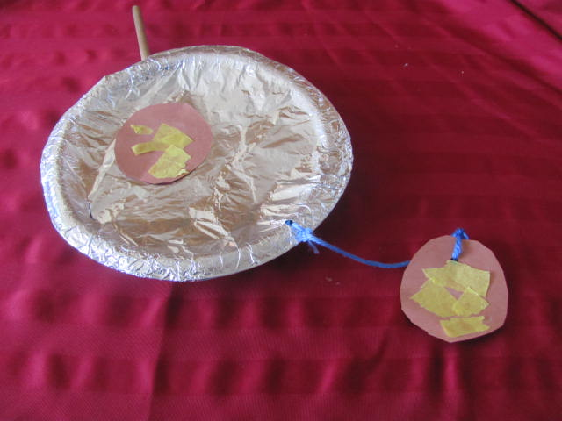
Latke Activities
Cooking latkes
Sampling latke toppings
Constructing and Playing frying pan-latke games (Catch the latke, Latke toss, hide the latke)

Slide 31
Latke Teaching Points
Latkes are pancakes made from potatoes
Latkes are cooked in oil
Oil and foods that are cooked in oil are eaten on Hanukkah to remind us of the special part which oil played in the Hanukkah story

Slide 32
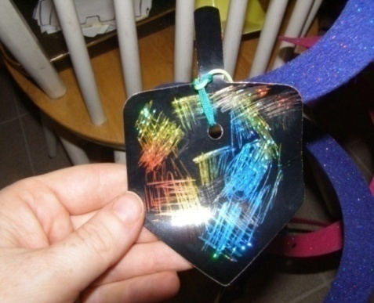
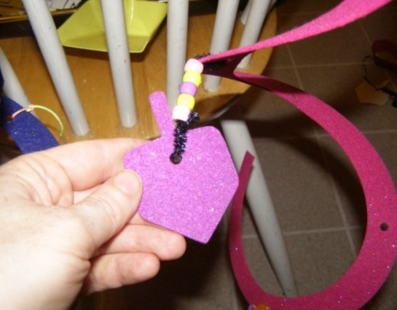
Additional Activities for Hanukkah Book-Based Programs
Making Hanukkah decorations
Decorating wrapping paper
Making Hanukkah presents (picture frames, memo holders, etc.)
Wrapping gifts to be given to
the needy
Singing Hanukah Songs

Slide 33
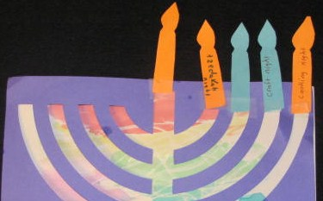
Nurturing the Family:
Take Home Materials
Ask parents to add to children’s menorahs by attaching candles upon which they have jotted down special activities for the families to do on specific days of Hanukkah
Send home or e-mail parents with directions for lighting the menorah, copies of the Hebrew Blessings in Hebrew transliteration and English, and a calendar listing upcoming Hanukkah events in the community

Slide 34
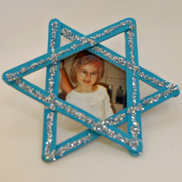
Suggestions for Enriching the Home Celebration of Hanukkah: Theme Nights
Book night- Read Hanukkah books and stories
Art night-Make Hanukkah
decorations, presents , etc.
Cooking night-make latkes,
sufganiyot, hanukkah cookies
edible dreidels

Slide 35
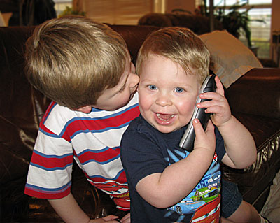
More Suggestions for Hanukkah Theme Nights:
Phone night-Call various relatives
and wish them a happy Hanukkah
Music night-Play Hanukkah songs,
sing and dance
Light night-Take a walk in your neighborhood. See how many different kinds of lights you can find.
Tzedekah night-Wrap presents for the needy, draw cards, drop the gifts off at a collection site

Slide 36


Compile a Listing of Hanukkah Events Occurring in Your Community
Latke Breakfast with Lisa Brown
Date: Nov 14
Time: 9:00 AM - 12:00 PM
Age Range: 0-5; 6-10; 11-14; 14+
Join us for some good food and fun as illustrator Lisa Brown reads from her book The Latke Who Wouldn't Stop Screaming, and revels in the true meaning of this holiday season.
Phone: 413-658-1100
Email: info@carlemuseum.org
Cost: Tickets event. Check website
Website: http://www.carlemuseum.org
Spin with Us! Beit Ahavah Chanukah Gala
Date: Dec 4
Time: 7:00 PM - 11:00 PM
Age Range: 11-14; 14+
Spin with Us! Beit Ahavah Chanukah Gala - from the Synagogue that re-invented Purim for adults, comes our new Chanukah Gala for adults and benefit to support sustainability, re-dedication and light for our community for years to come.
Silent Auction, live cash bar, klezmir music, great dancing, performances and Hors d'œuvres, with menorah lighting and celebration.
Center for the Arts
17 New South St.
Northampton, MA 01060
Phone: 413-587-3770
Email: info@beitahavah.org
Website: http://www.beitahavah.org

